Slide 1

深度学习在功能基因组学领域的研究进展
汇报人：王临孝

Slide 2

Training content
1
Introduction
2
Basic knowledge of deep learning
3
Model architecture for predicting functional genomics
4
Model explanation
5
Practice

Slide 3
Part Ⅰ: Introduction

Slide 4
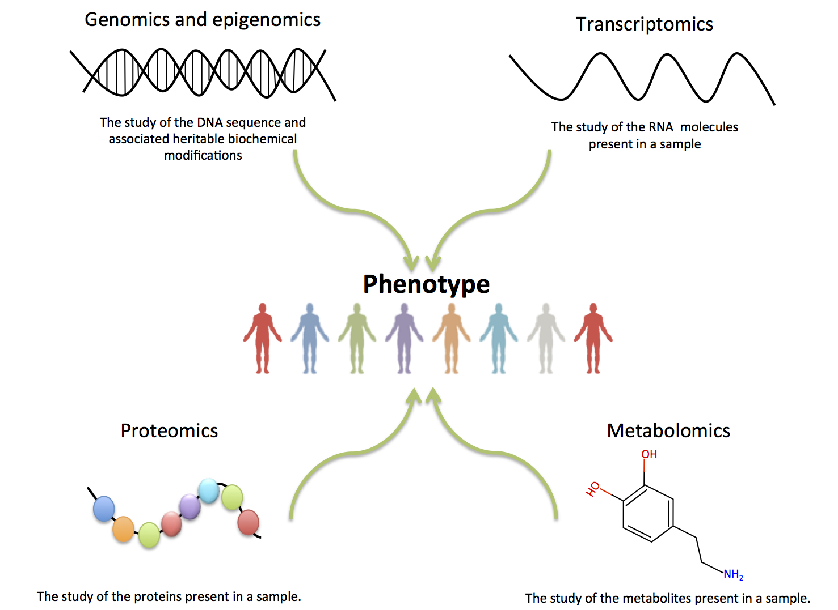
What is functional genomics ?
When and where are genes expressed?
How do gene expression levels differ in various cell types and states?
What are the functional roles of different genes and in what cellular processes do they participate?
How are genes regulated? Where are the active gene promoters in a particular cell type?
Notes:
功能基因组学的研究目标是从基因组层面理解基因型和表型之间的关联，该研究涉及多个生物学过程包括转录、翻译以及表观修饰。When and where are genes expressed?
How do gene expression levels differ in various cell types and states?
What are the functional roles of different genes and in what cellular processes do they participate?

Slide 5
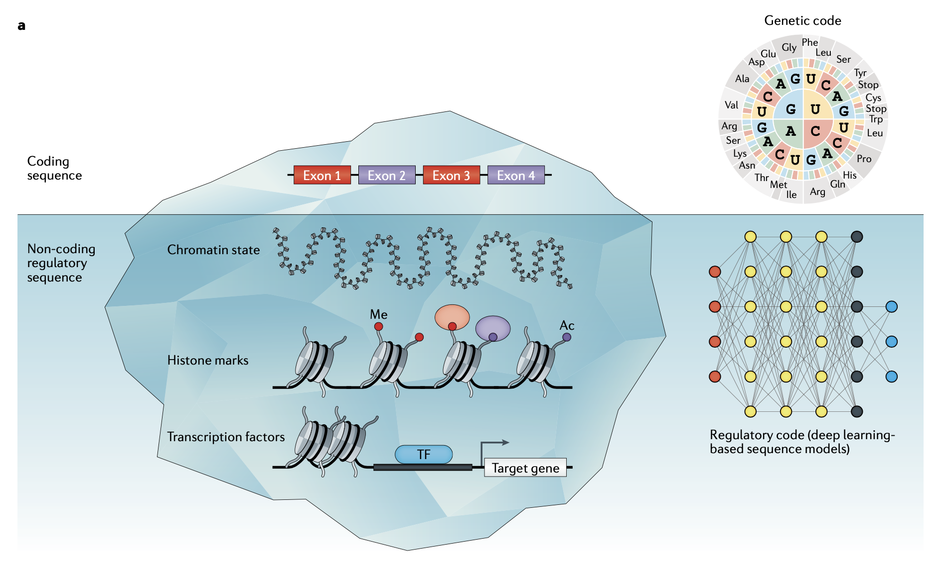
The importance of functional genomics
The proportion of non-coding regions in the human genome is 99%, and non-coding regions contain a large number of regulatory elements
(Wong AK, et al. Decoding disease: from genomes to networks to phenotypes. Nat Rev Genet)
Notes:
非编码区占基因组的比例是99%，并且内含有大量调控元件。GWAS找到的与表型关联snp位点大多位于非编码区
通过深度学习建立预测模型，可以有助于理解非编码区突变对转录调控所带来的影响

Slide 6
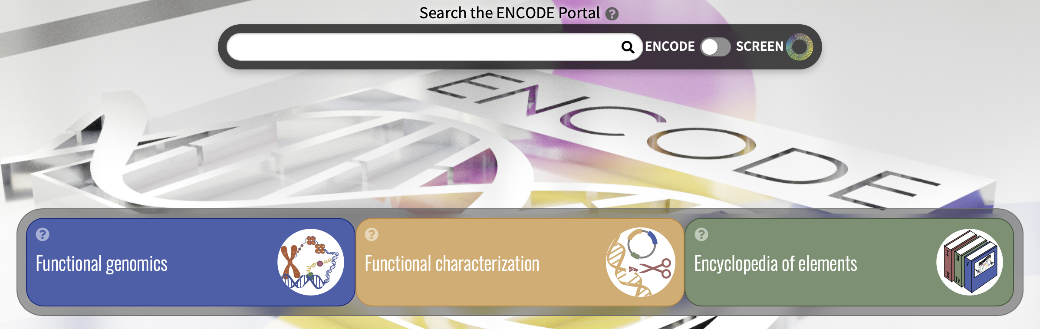
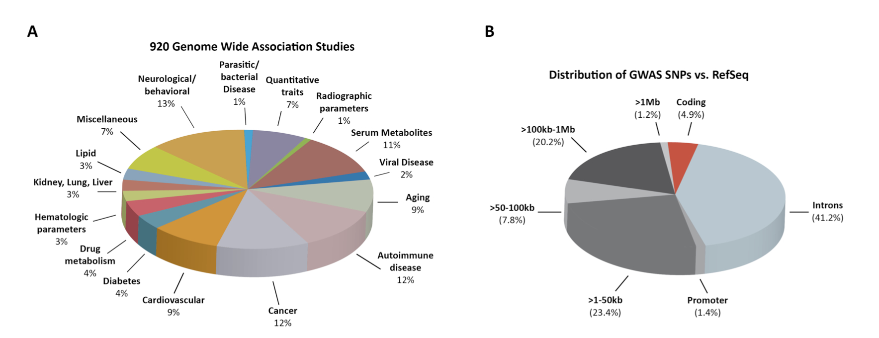

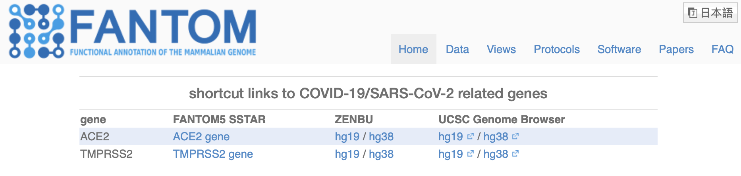
The importance of functional genomics
Only 4.9% of the SNPs associated with the disease found by GWAS were located in the coding region
https://www.encodeproject.org
http://www.roadmapepigenomics.org
https://fantom.gsc.riken.jp
(Maurano MT, Humbert R, Rynes E, et al. Science. 2012;337(6099):1190-1195)
Notes:
Encode功能基因组学
Roadmap表观基因组学（human），包括甲基化、各种组蛋白修饰、染色质开放
Fantom实验测得的human genome功能注释信息，包括enhancer，promoter，long non-coding RNA
随着测序技术的进步，不同组织和cell type的表观数据被测序得到，因此可以使用深度学习对其进行整合分析，进而去研究一些生物学问题

Slide 7
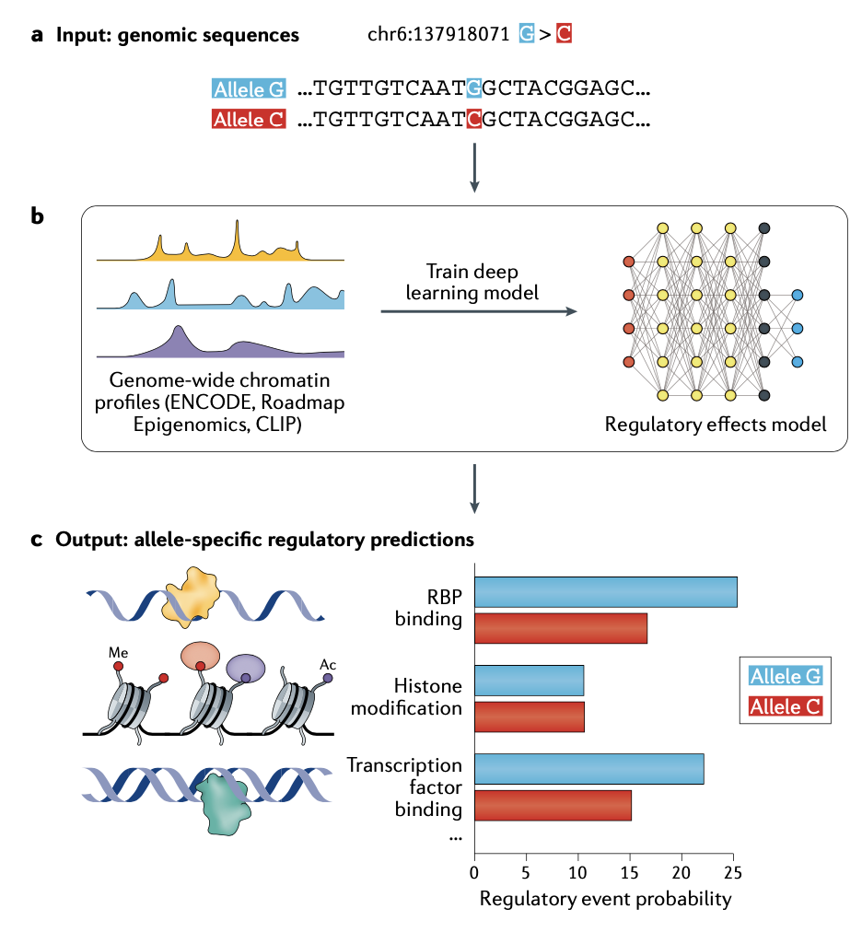
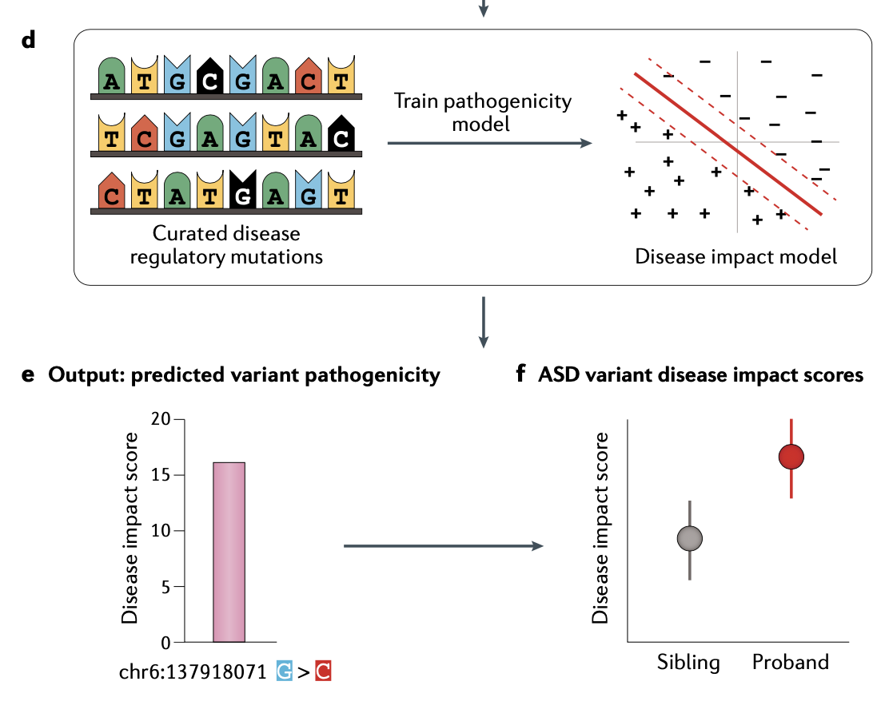
The framework of decoding disease using deep learning
(Wong AK, et al. Decoding disease: from genomes to networks to phenotypes. Nat Rev Genet)
Notes:
根据已知与疾病相关的snp突变，根据这些snp的表观特征结果，我们可以训练一个预测模型。
这样，我们就可以任何突变的致病性进行预测，根据的就是这个突变的模型预测值
该项工作应用于自病症研究中，发现与自病症相关联的突变，proband有更高的疾病影响

Slide 8
Part Ⅱ: Basic knowledge of deep learning

Slide 9
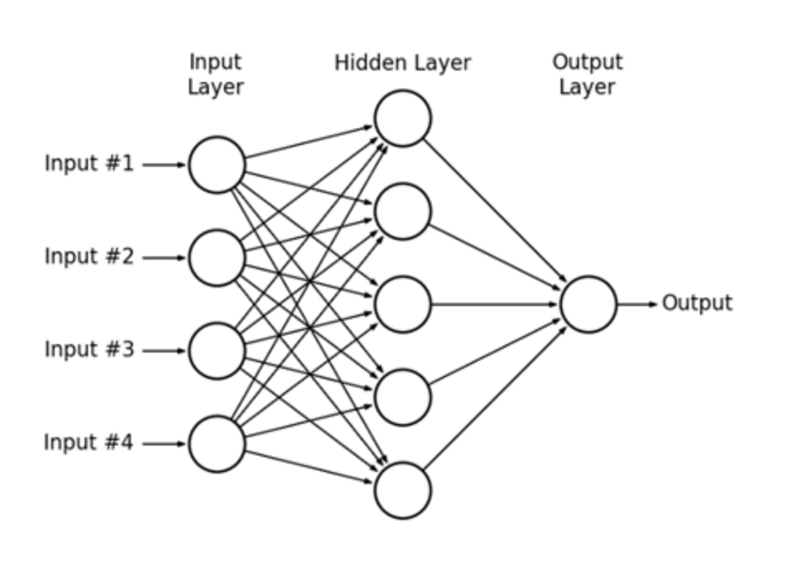
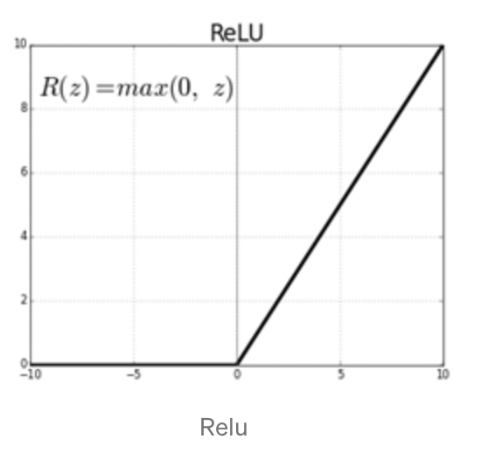
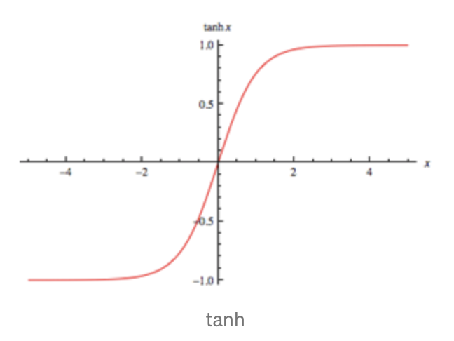
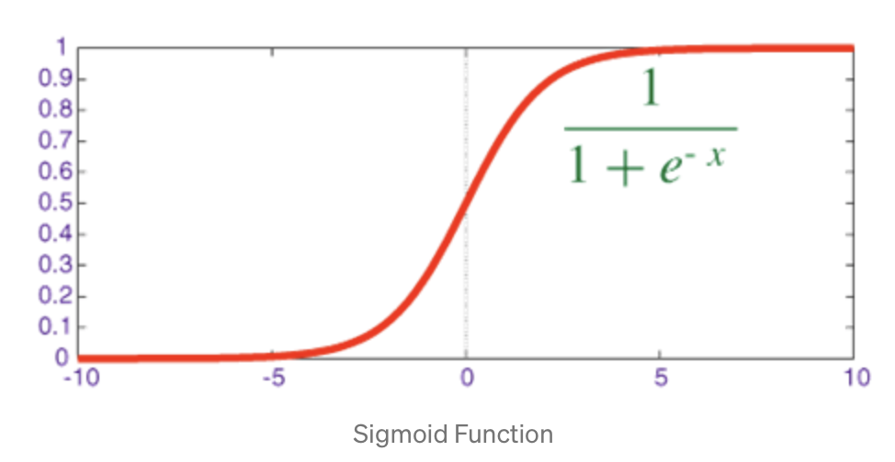
Artificial neutral network(ANN)
Activation function
Notes:
激活函数的作用是改变数据线性关系。,如果网络中全部是线性变换,则多层网络可以通过矩阵变换,直接转换成一层神经网络。所以激活函数的存在,使得神经网络的“多层”有了实际的意义,使网络更加强大,增加网络的能力,

Slide 10
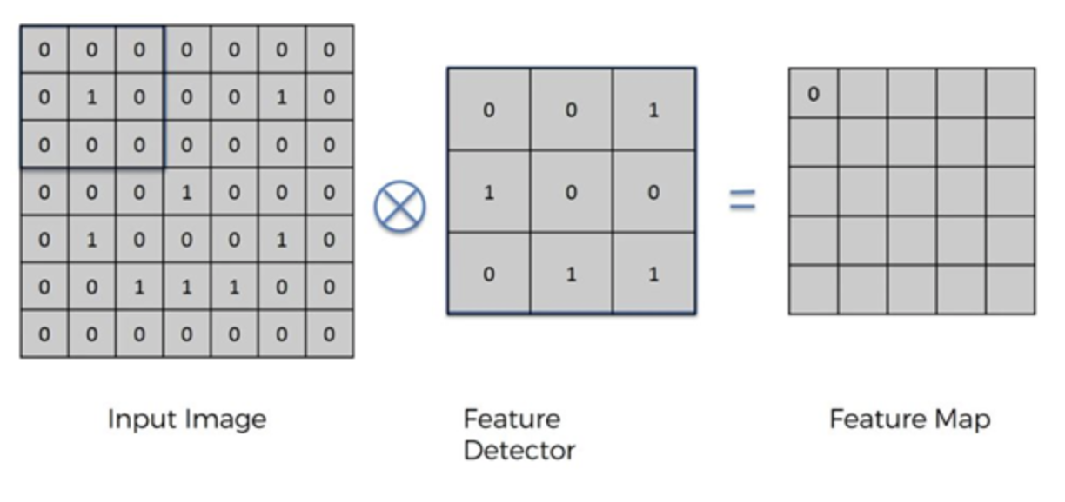
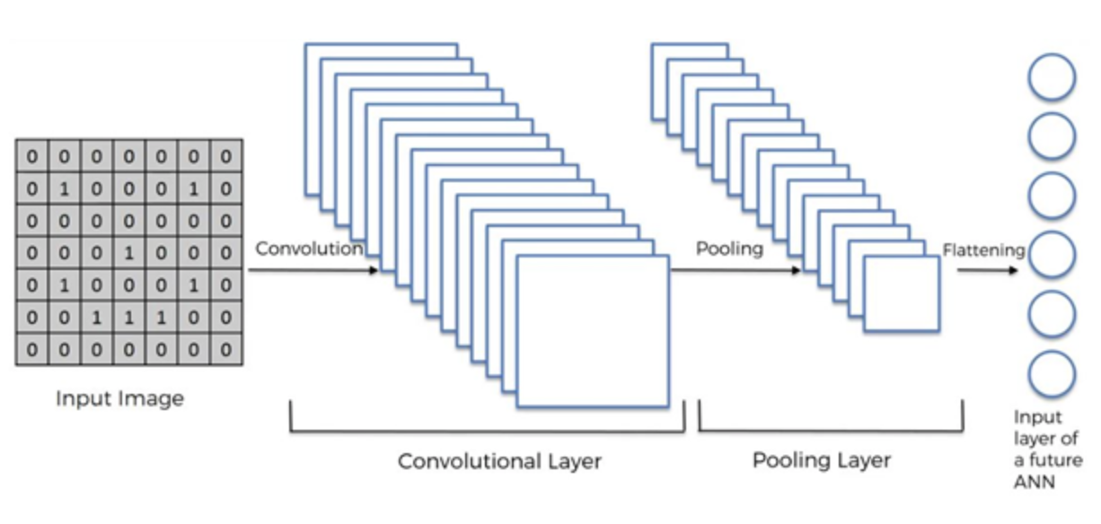
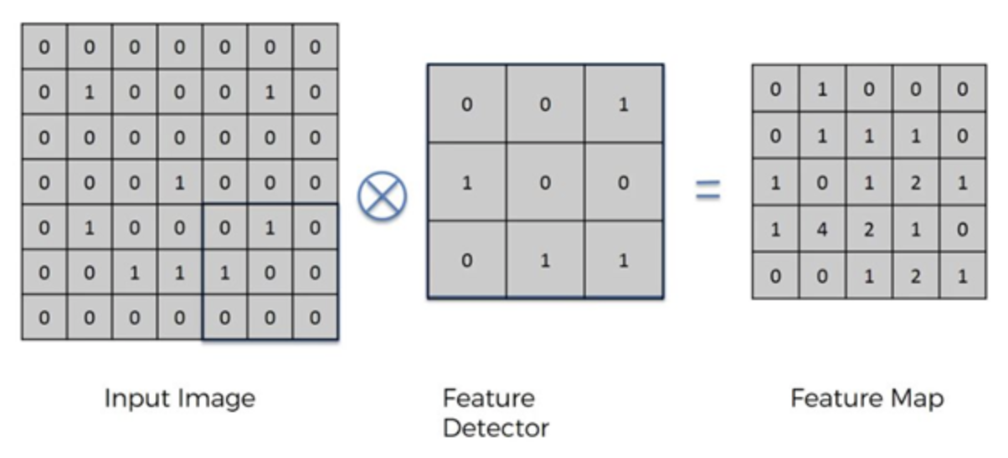
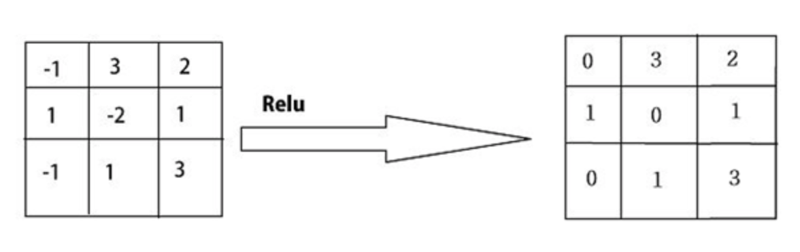
Convolutional neutral network(CNN)
1. Convolutional layer
Notes:
卷积神经网络包括四个部分
卷积层的作用是模型提取输入的特征

Slide 11
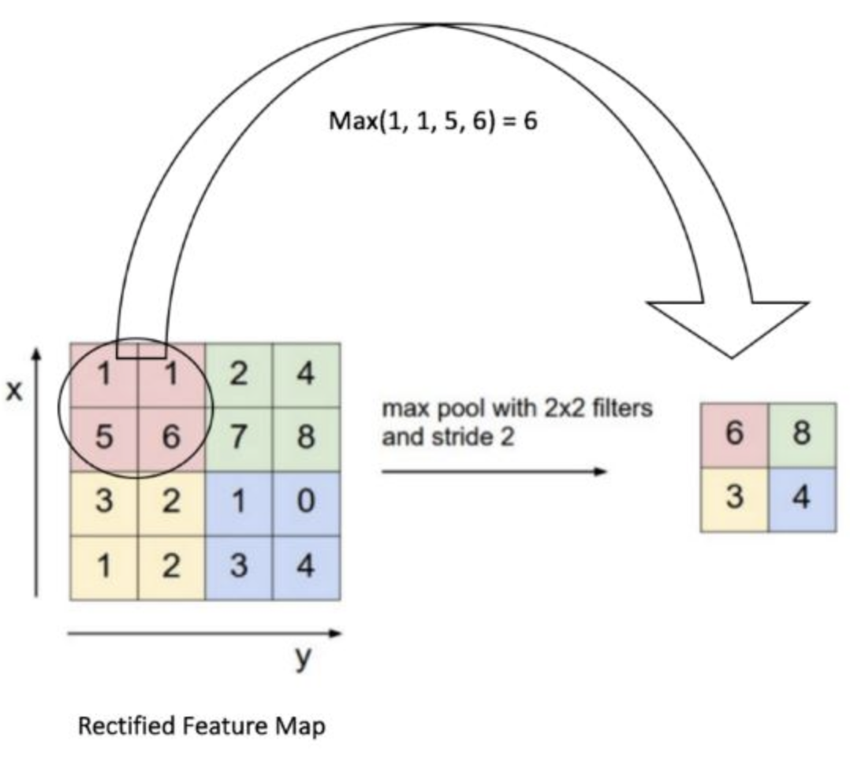
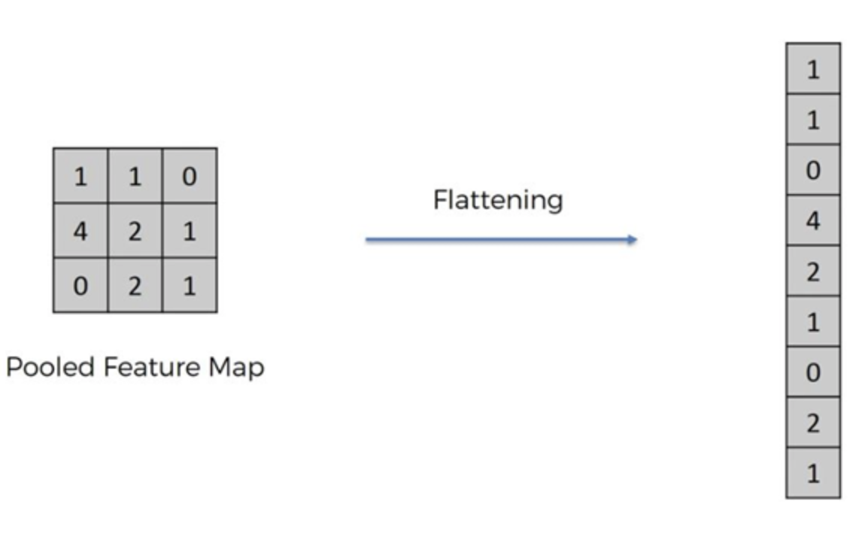
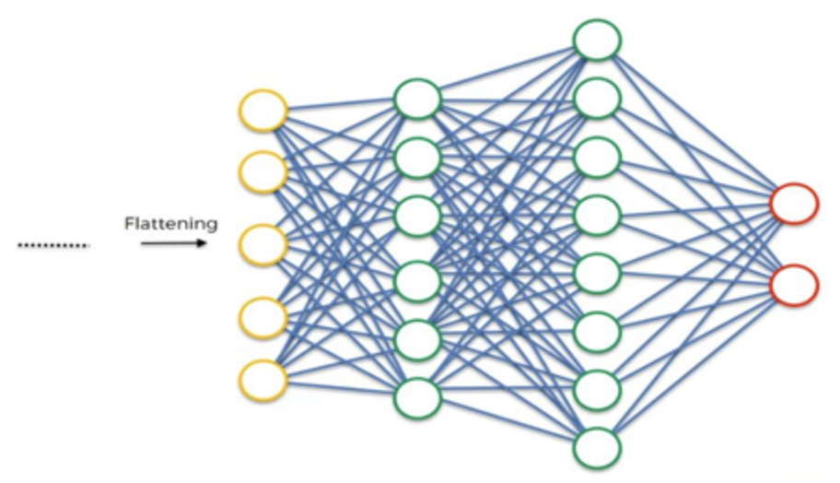
Convolutional neutral network(CNN)
2. Pooling layer
3. Flattening
4. Fully connection
Notes:
池化层的作用：降维、去除冗余信息、对特征进一步压缩
全连接层：对输入进行分类

Slide 12
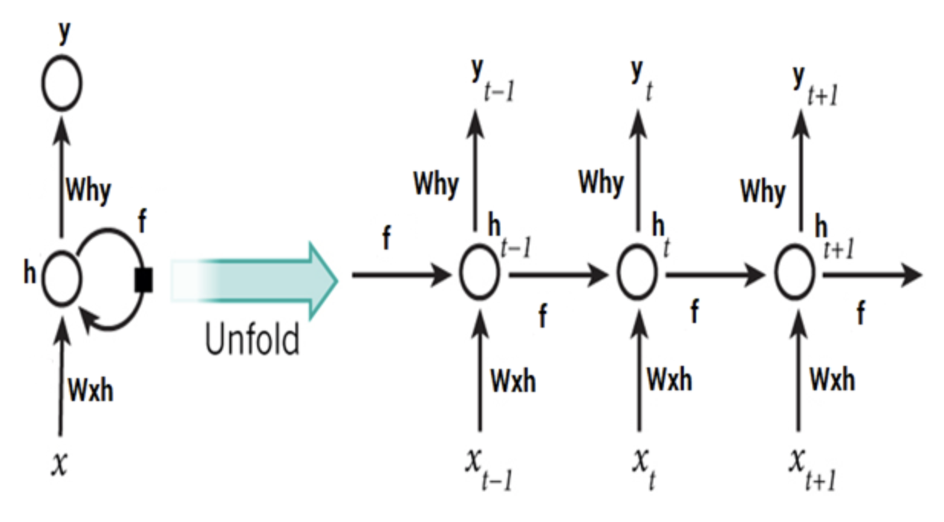
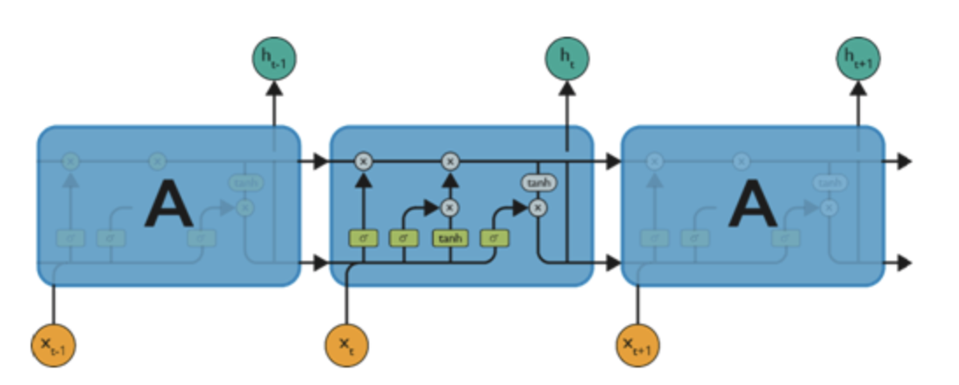
Recurrent neutral network(RNN)&LSTM
The traditional RNN has problems such as gradient disappearance or gradient explosion, so LSTM is usually used
LSTM adds additional data streams to store information for later use, thus preventing earlier signals from disappearing during processing
Notes:
传统的RNN会出现梯度消失或者梯度爆炸等问题，因此使用LSTM
LSTM添加了额外的数据流，可以保存信息以便后面使用，从而防止较早期的信号在处理过程中逐渐消失

Slide 13
Part Ⅲ: Model architecture for predicting functional genomics

Slide 14
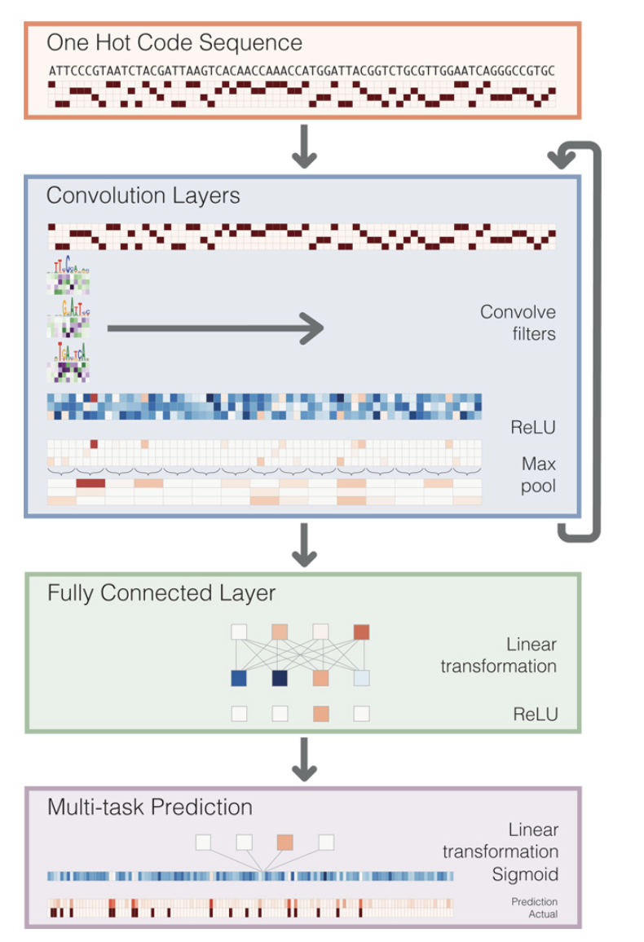
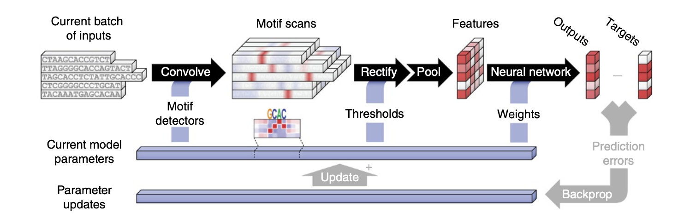
Multi-task prediction architecture
(Alipanahi B, et al. Predicting the sequence specificities of DNA- and RNA-binding proteins by deep learning. Nat Biotechnol)
(Kelley DR, et al. Basset: learning the regulatory code of the accessible genome with deep convolutional neural networks. Genome Res.)
Notes:
输入是五条独立的序列，在模型反向传播和梯度下降去优化模型的参数

Slide 15
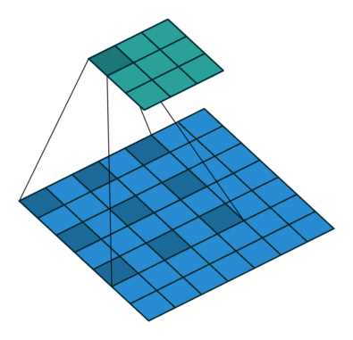
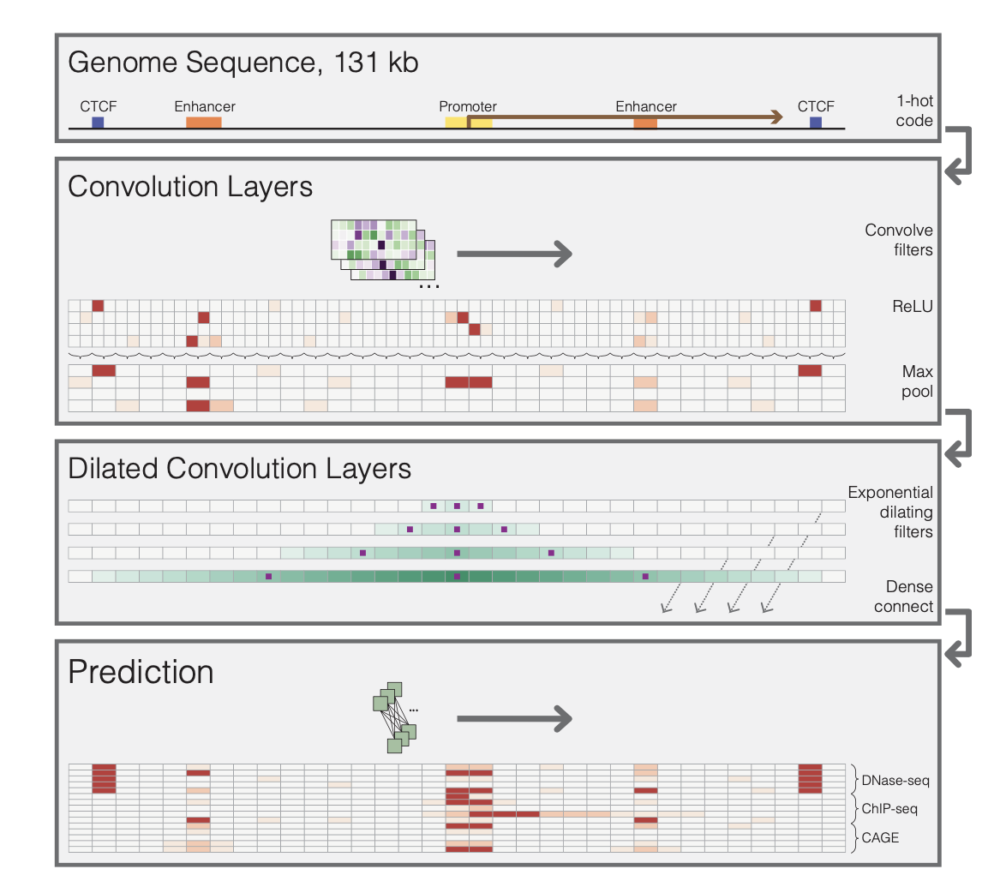

Variant of convolutional neural network(一)
Dialated convolution can expand the receptive field, so the model can integrate the signals of regulatory elements at the far end of the genome
Dialated convolution
Normal convolution
(Kelley DR, et al. Sequential regulatory activity prediction across chromosomes with convolutional neural networks. Genome Res.)
Notes:
膨胀卷积和transformer可以扩大感受野，可以整合基因组远端的调控元件（例如enhancer）

Slide 16
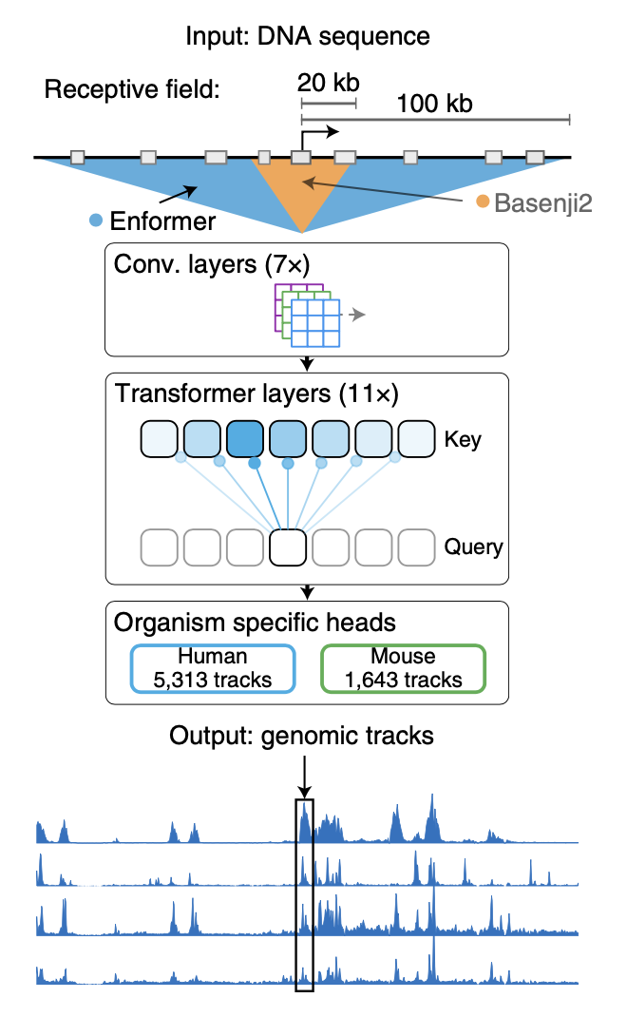
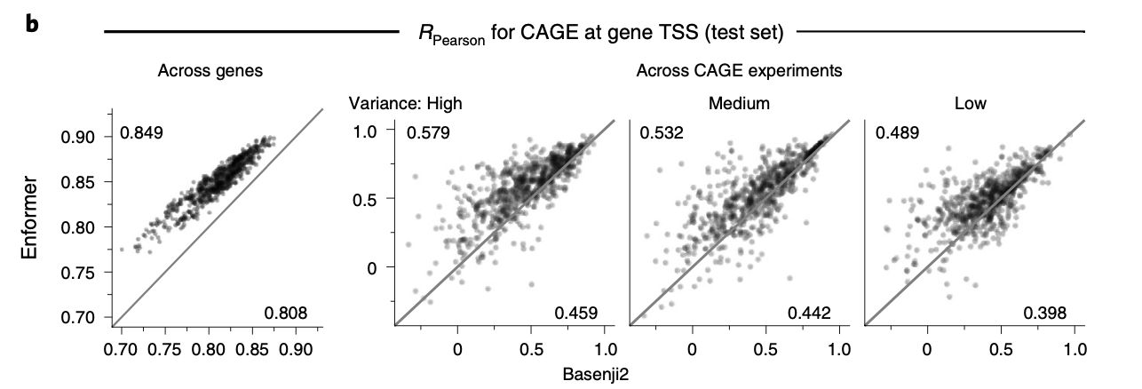
Variant of convolutional neural network(二)
(Avsec Ž, et al. Effective gene expression prediction from sequence by integrating long-range interactions. Nat Methods.)
Notes:
使用transformer比膨胀卷积预测基因表达的准确率更高

Slide 17
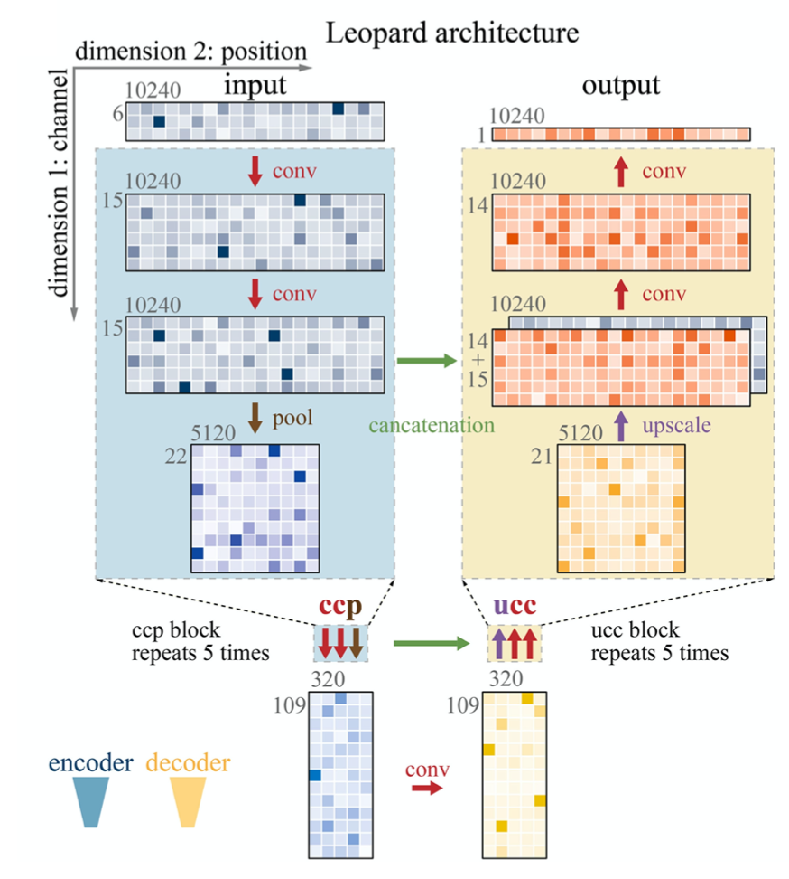
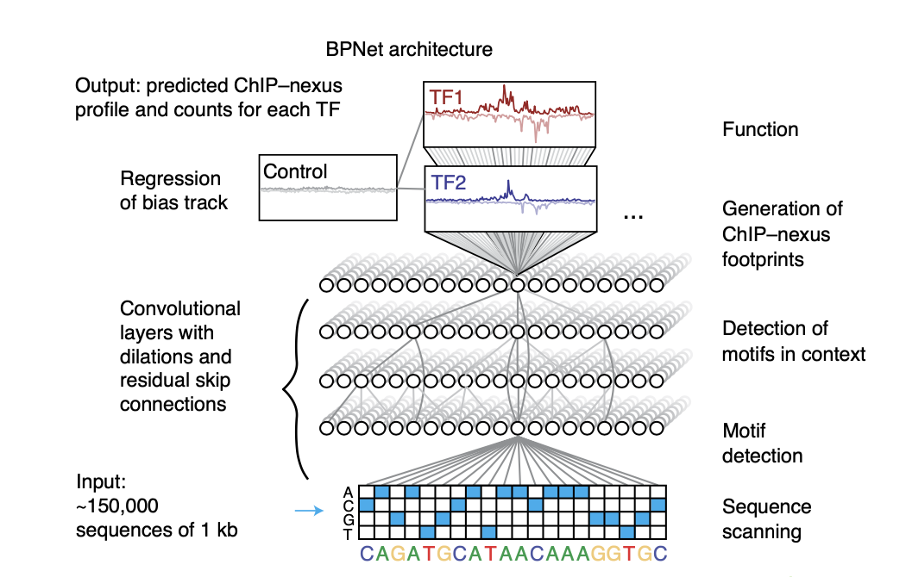
Deconvolution network
(Li H, Guan Y. Fast decoding cell type-specific transcription factor binding landscape at single-nucleotide resolution. Genome Res.)
(Avsec Ž, et al. Base-resolution models of transcription-factor binding reveal soft motif syntax. Nat Genet.）
Notes:
之前的模型都是一个二分类预测模型，预测输入是否属于某个特征，预测值在0～1之间。
通过反卷积输出每个输入位点的预测结果

Slide 18
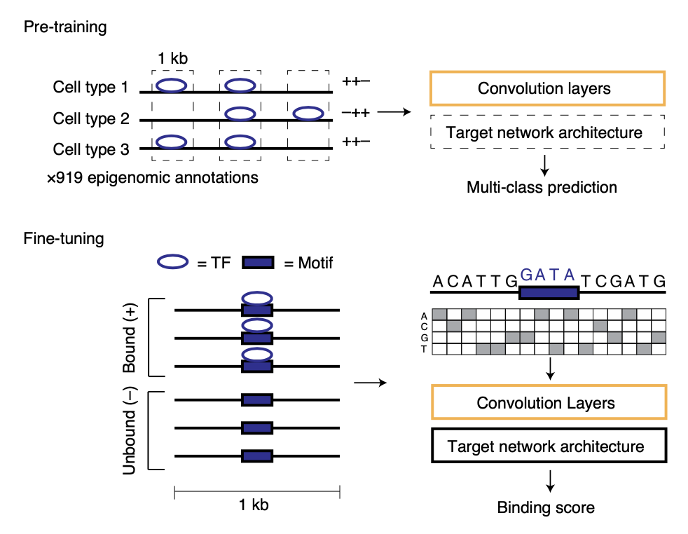
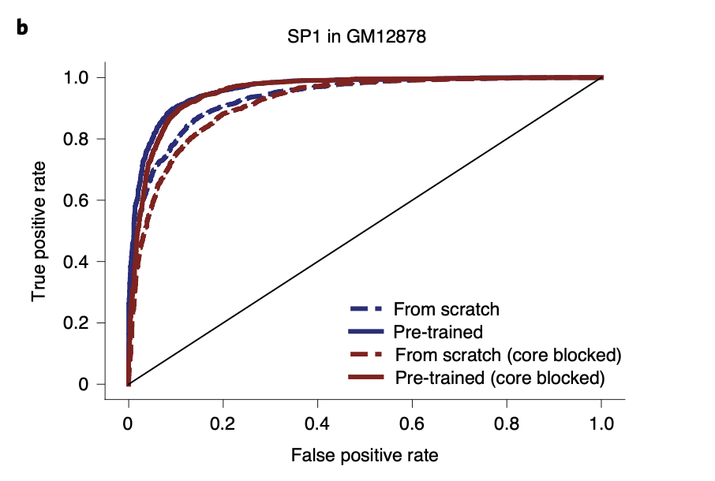
Transfer learning
A motif can occur many thousands of times in the human genome, but only a subset of those sites are actually bound
(Zheng A, et al. Deep neural networks identify sequence context features predictive of transcription factor binding. Nat Mach Intell.)
Notes:
作者使用迁移学习训练38个淋巴母细胞系的转录因子预测模型

Slide 19
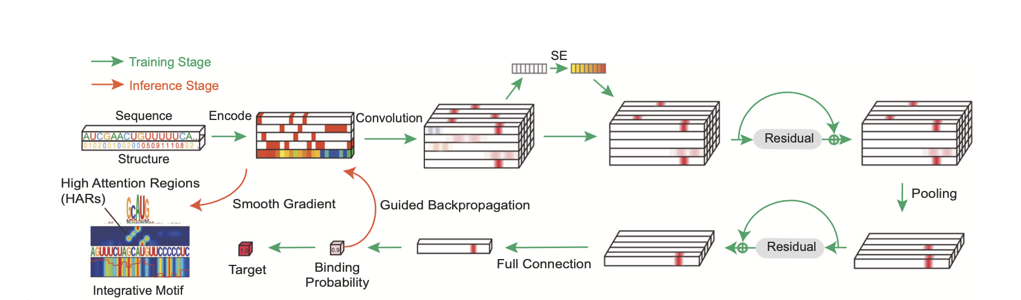
Multimodal model
The input features include RNA sequence encoded in the 4-dimensional one-hot encoding, and the use of icSHAPE structural scores as the fifth-dimension.
The neural network consists of multiple convolutional layers, squeeze-and-excitation (SE) networks, and residual blocks to capture the joint sequence-and-structural determinants of RBP binding
(Sun L, et al. Predicting dynamic cellular protein-RNA interactions by deep learning using in vivo RNA structures. Cell Res.)
Notes:
Squeeze-and-excitation networks: SE net

Slide 20
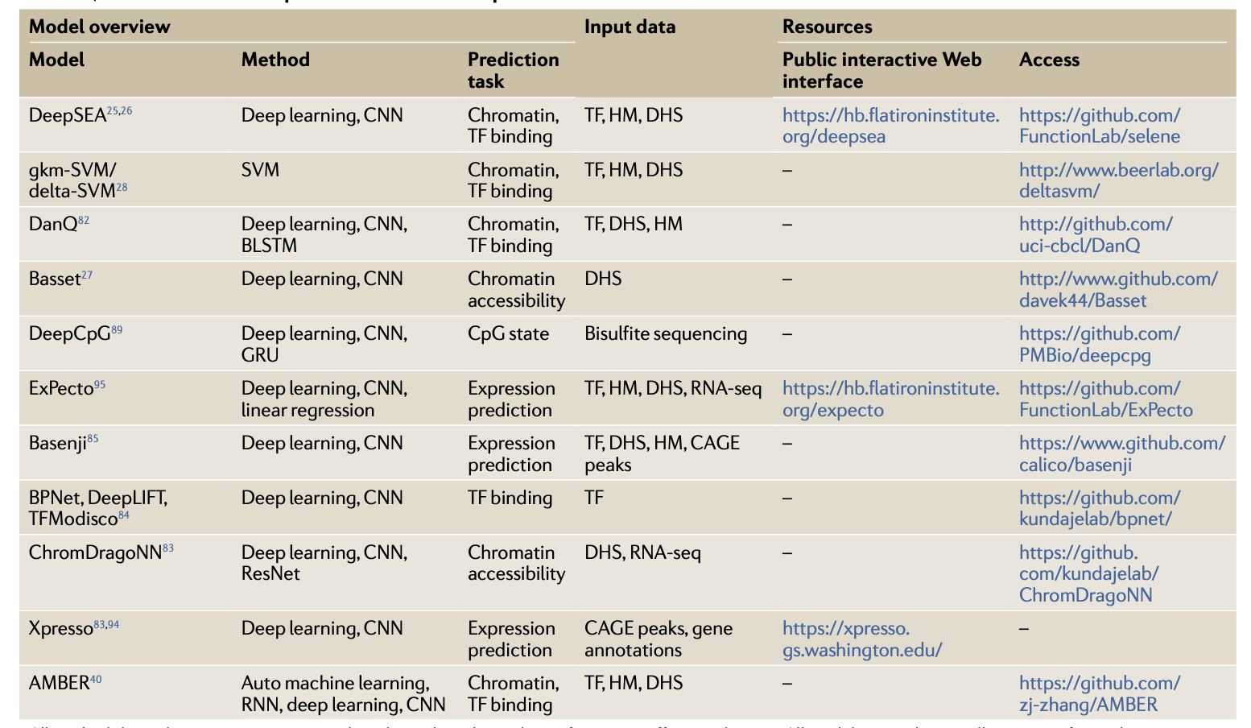
Summary(一)
Model for transcriptional impact
(Wong AK, et al. Decoding disease: from genomes to networks to phenotypes. Nat Rev Genet)
Notes:
主要预测开放，组蛋白修饰，TF binding

Slide 21
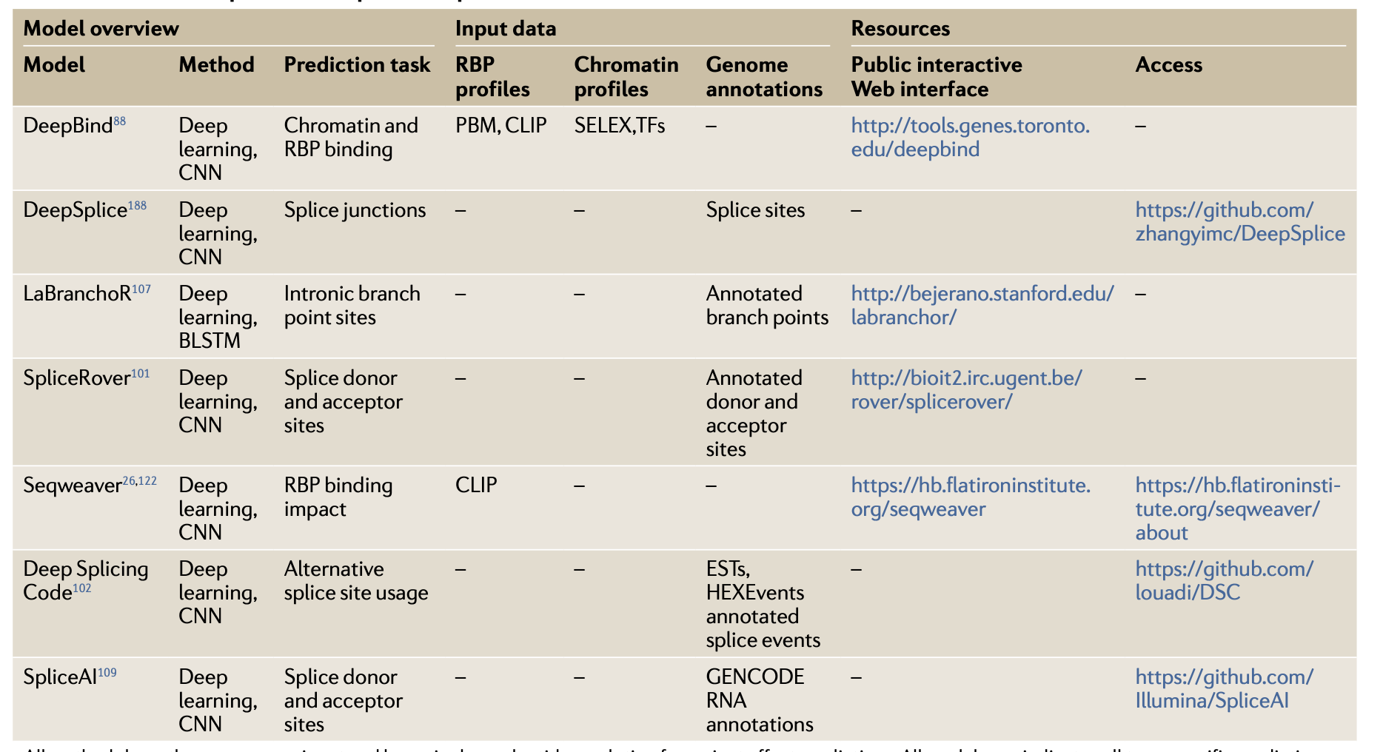
Summary(二)
Model for post-transcriptional impact
(Wong AK, et al. Decoding disease: from genomes to networks to phenotypes. Nat Rev Genet)
Notes:
预测RNA binding和可变剪切位点

Slide 22
Part Ⅳ: Model explanation

Slide 23
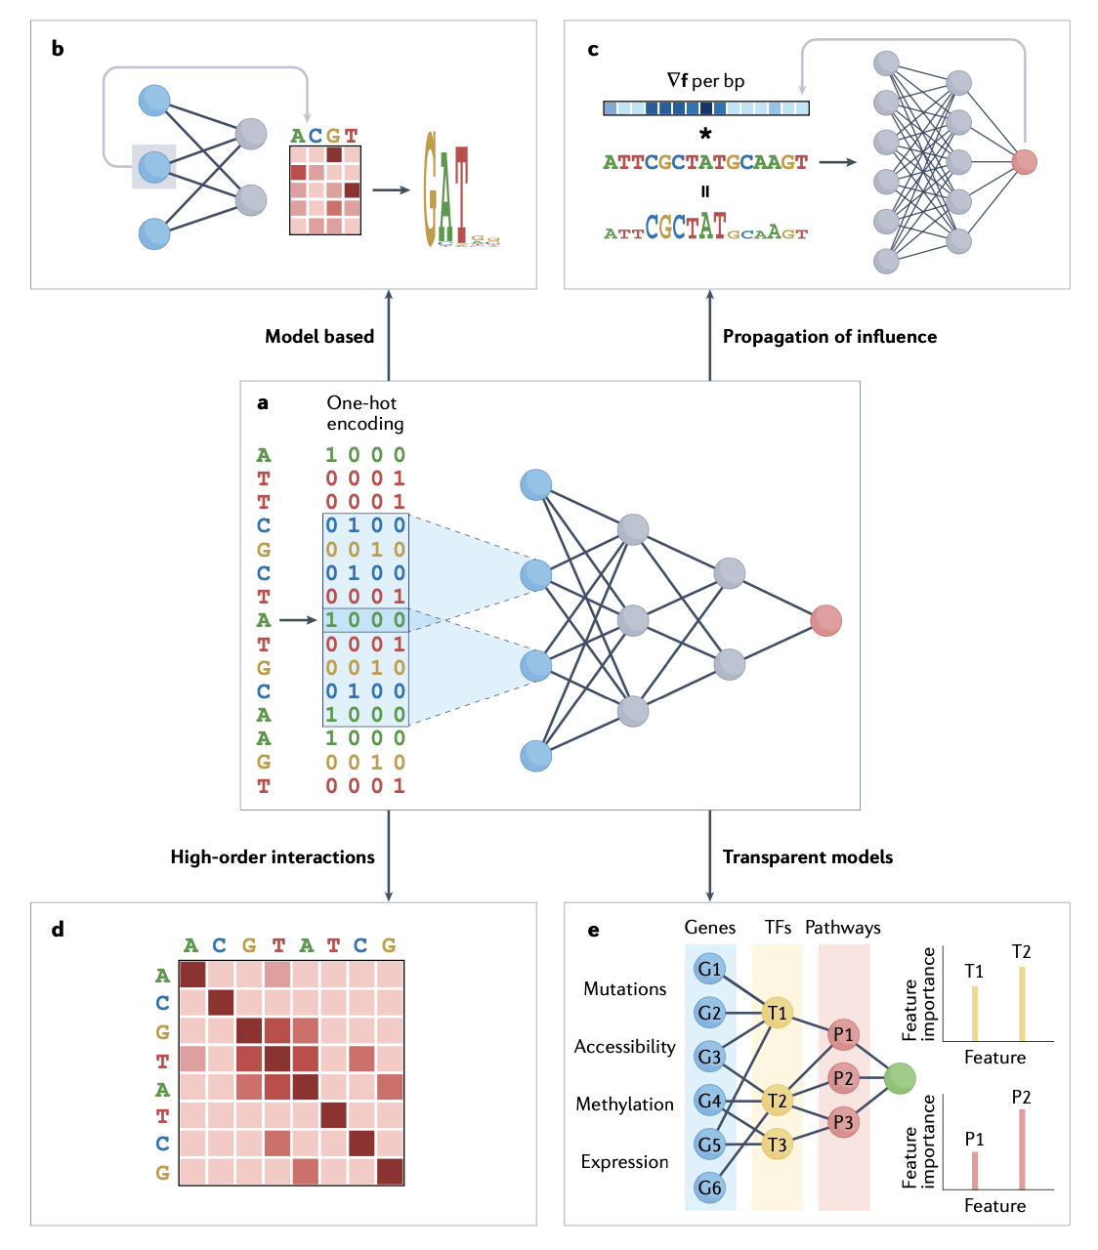
Study model interpretability from four perspectives
(Sharmin M, et al. The dynamic, combinatorial cis-regulatory lexicon of epidermal differentiation. Nat Genet.)
Notes:
转录因子的协同作用，因此研究motif之间的关联影响

Slide 24
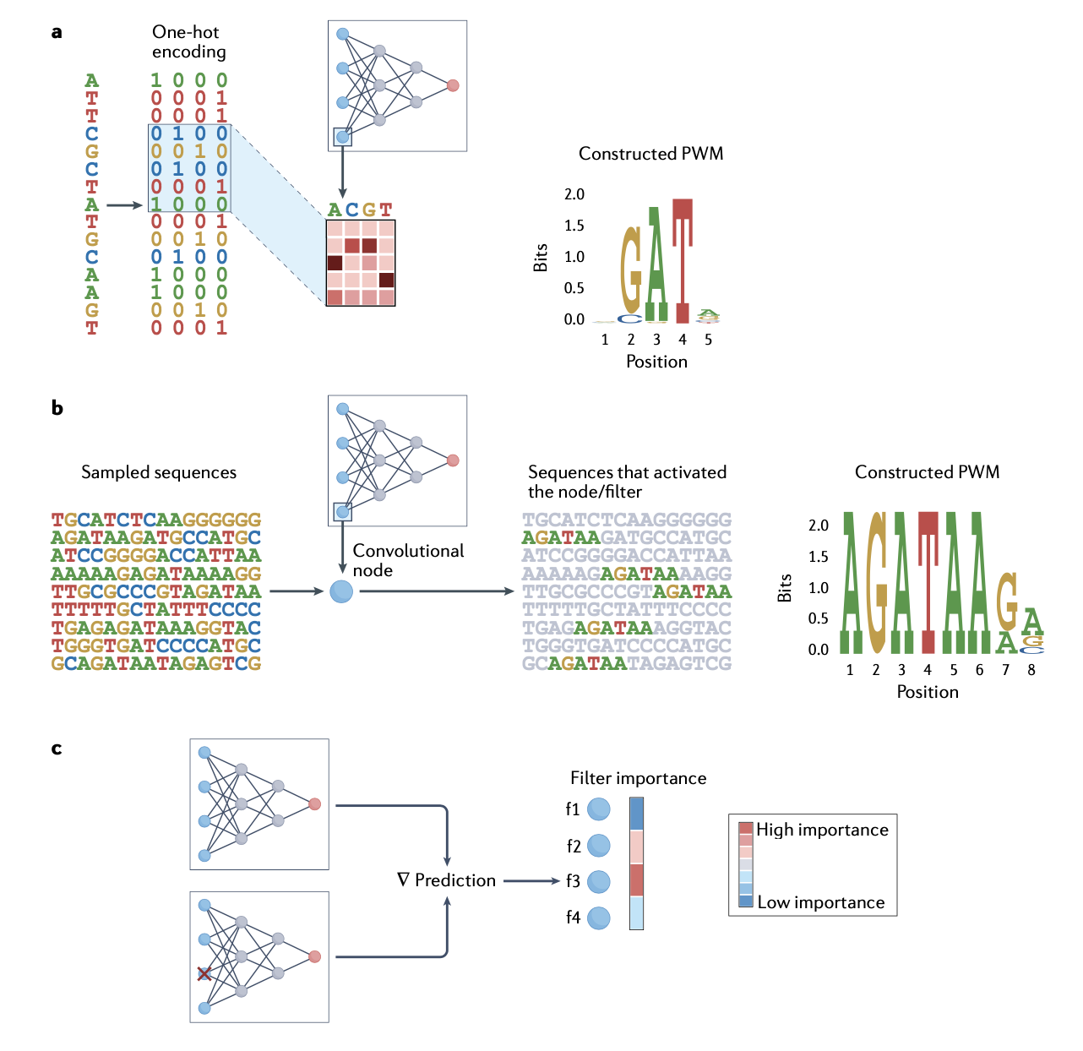
Model based interpretation
(Sharmin M, et al. The dynamic, combinatorial cis-regulatory lexicon of epidermal differentiation. Nat Genet.)
Notes:
Basset共有300个卷积核，其中有45%可以注释到motif

Slide 25
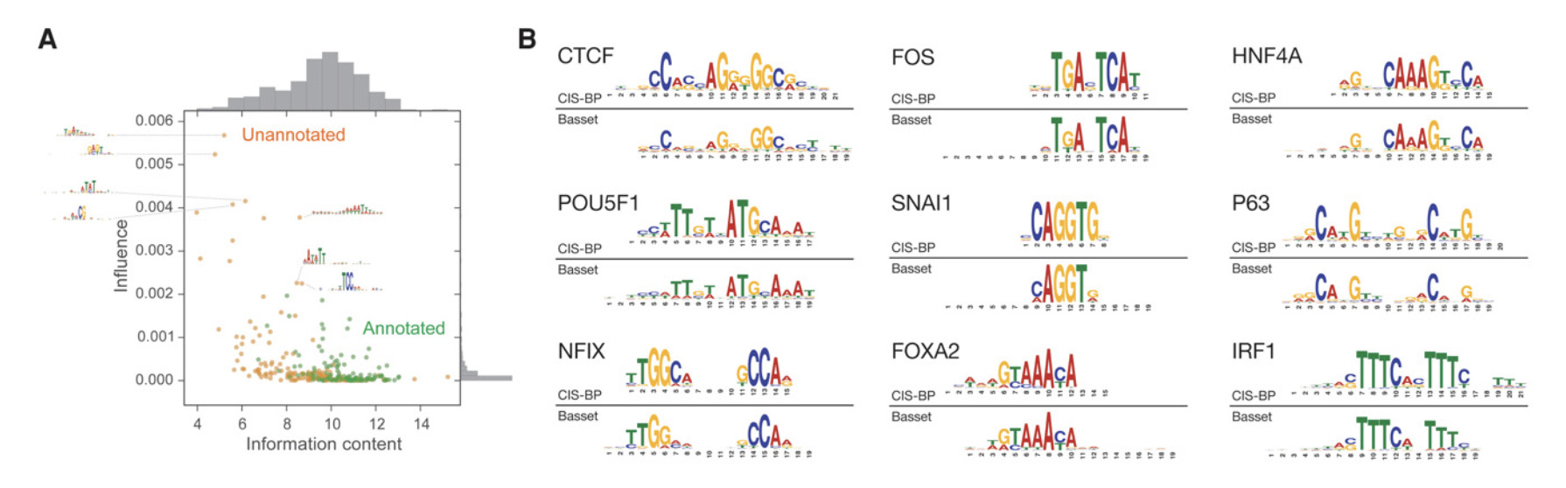
Model based interpretation
Basset model has 300 convolutional filters in the first layer, 45% of which can be annotated with the transcription factor motif
(Kelley DR, et al. Basset: learning the regulatory code of the accessible genome with deep convolutional neural networks. Genome Res.)
Notes:
Basset预测DNA染色质开放区域

Slide 26
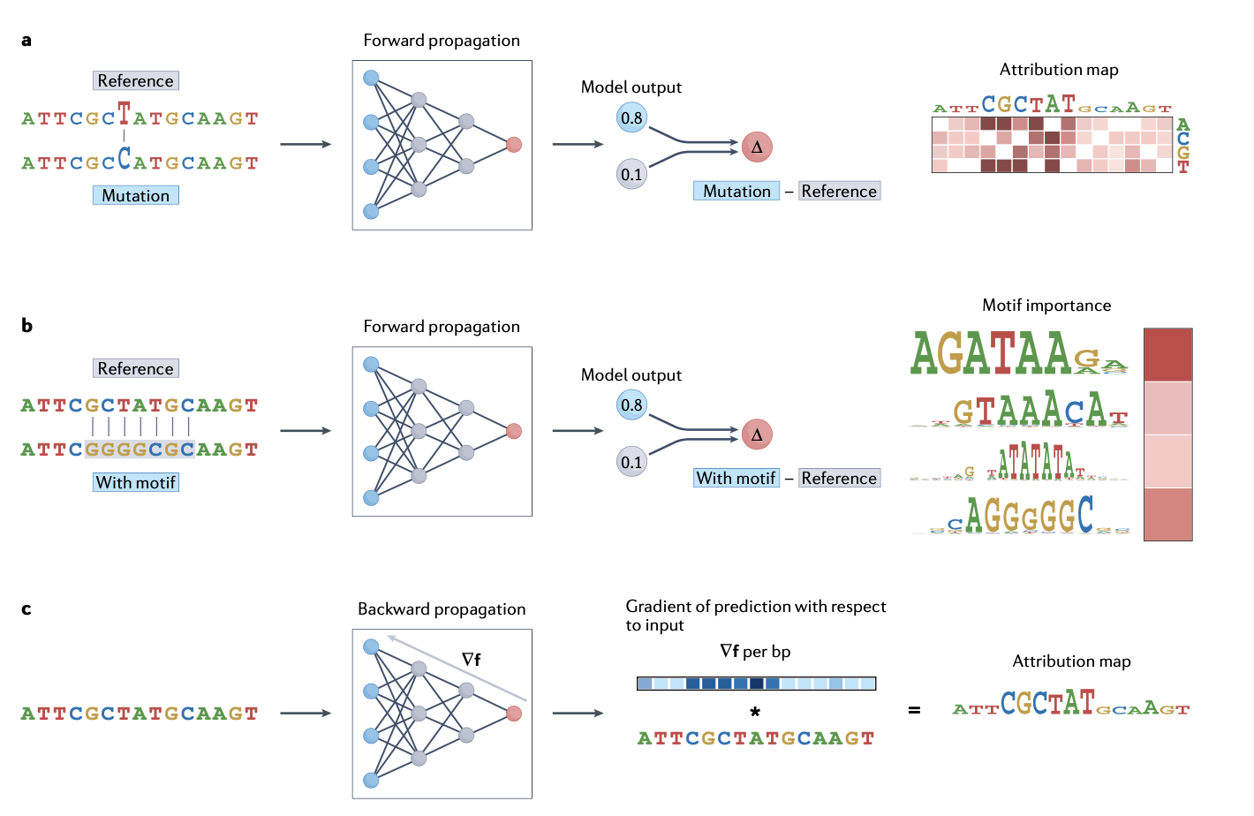
Propagation based interpretation
(Sharmin M, et al. The dynamic, combinatorial cis-regulatory lexicon of epidermal differentiation. Nat Genet.)
Notes:
基于前向传播或反向传播理解模型

Slide 27
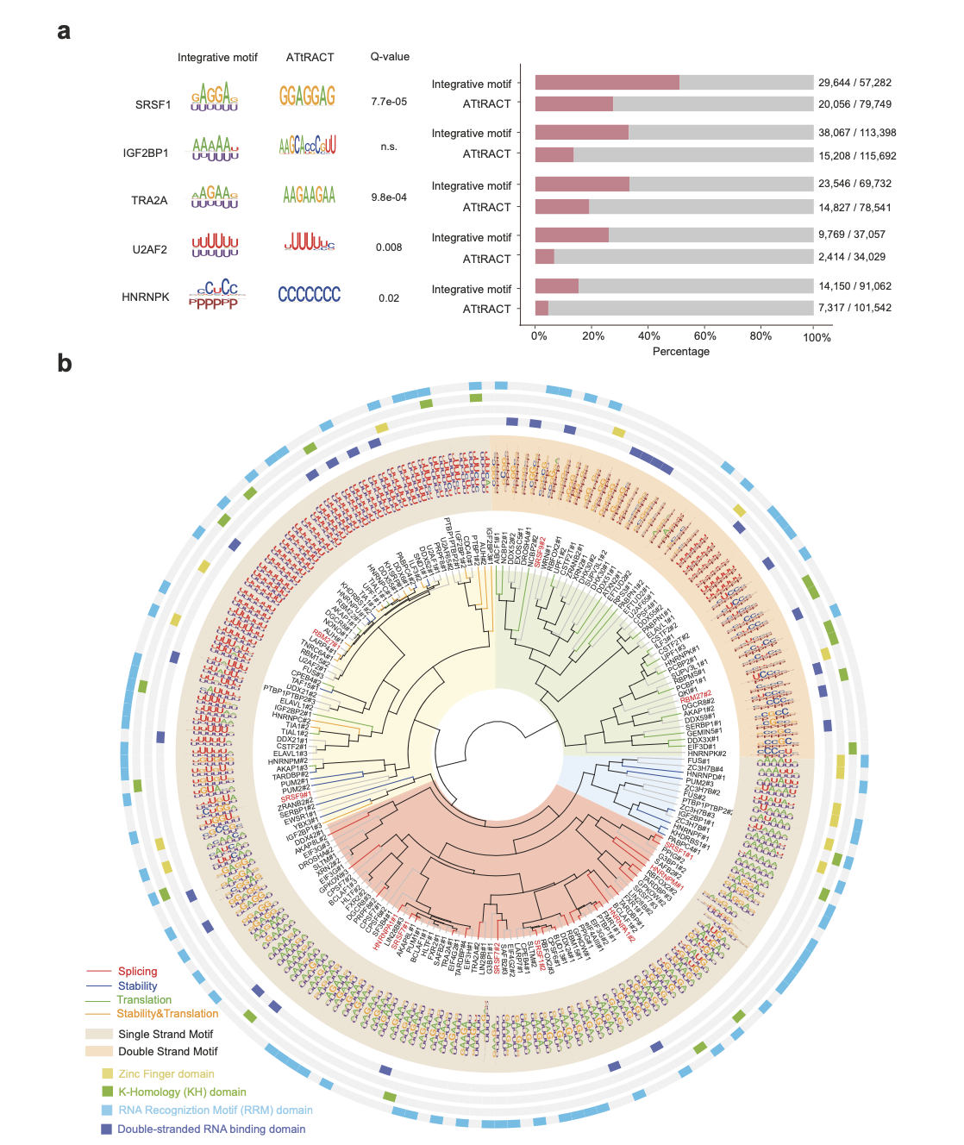
Propagation based interpretation
Prismnet use smooth-grad to detect the significance of RNA binding region and identify the motif of the input sequence
These motifs can be clustered into four categories: splicing, stability, translation, stability&translation
(Sun L, et al. Predicting dynamic cellular protein-RNA interactions by deep learning using in vivo RNA structures. Cell Res.)
Notes:
预测RNA binding

Slide 28
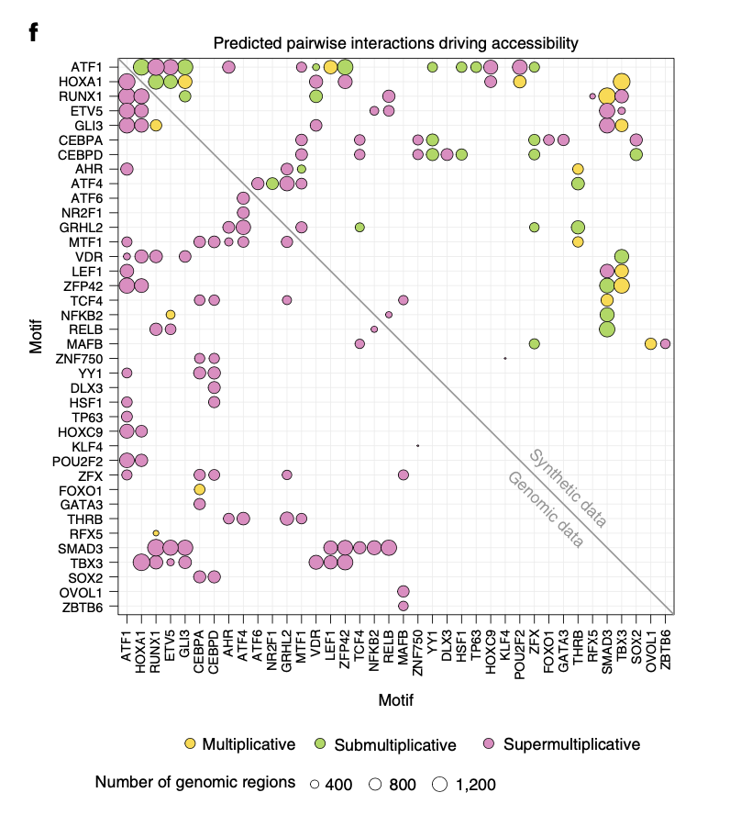
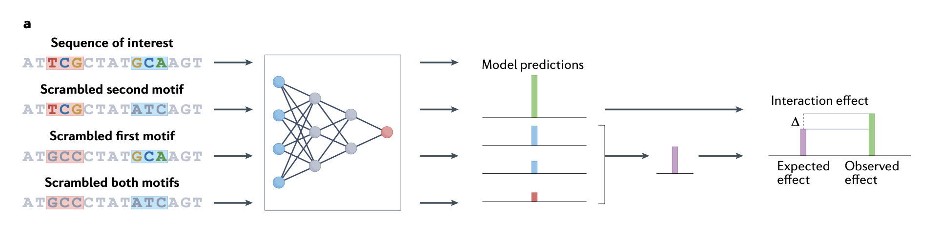
Reveal interactions between features in model performance
(Sharmin M, et al. The dynamic, combinatorial cis-regulatory lexicon of epidermal differentiation. Nat Genet.)
(Kim DS, et al. The dynamic, combinatorial cis-regulatory lexicon of epidermal differentiation. Nat Genet.)
Notes:
表皮细胞系染色质开放区域motif的协同关系

Slide 29
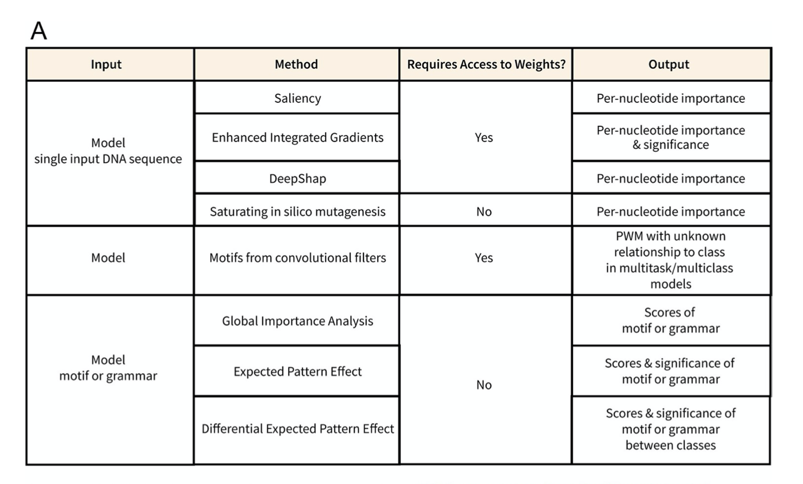
Summary
(Hammelman J, Gifford DK. Discovering differential genome sequence activity with interpretable and efficient deep learning. PLoS Comput Biol. 2021)
Notes:
根据输入来决定可解释性的方向

Slide 30
Part Ⅴ: Practice

Slide 31
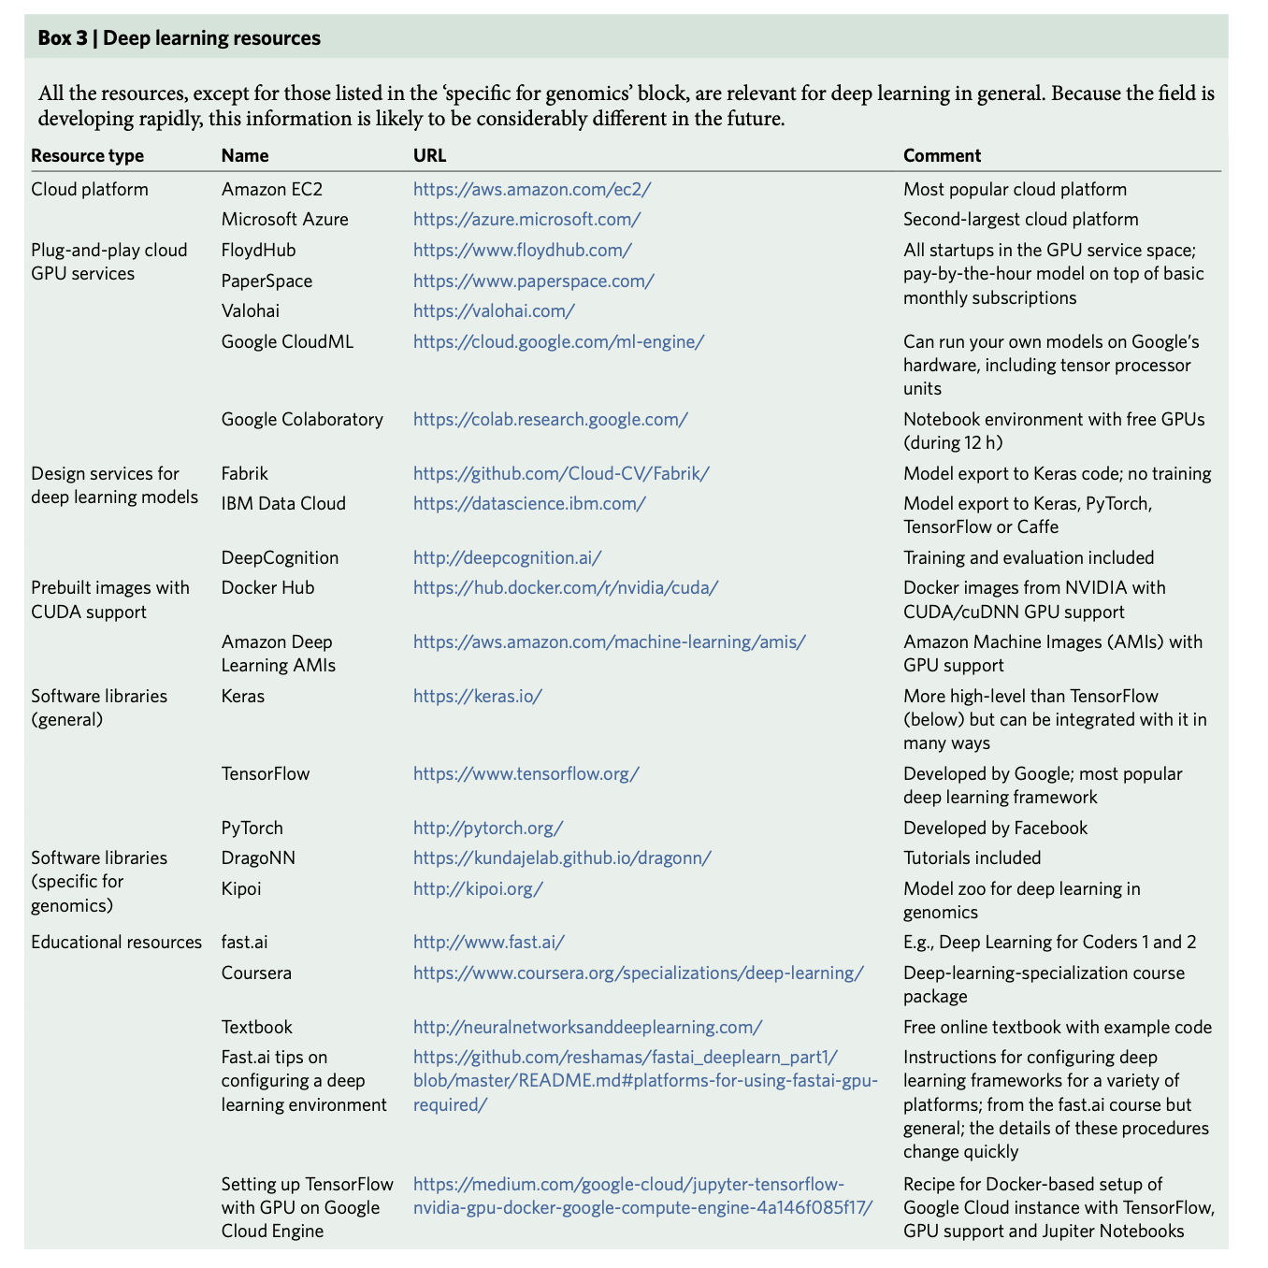
Deep learning resources(一)
(Zou J, et al. A primer on deep learning in genomics. Nat Genet.)

Slide 32
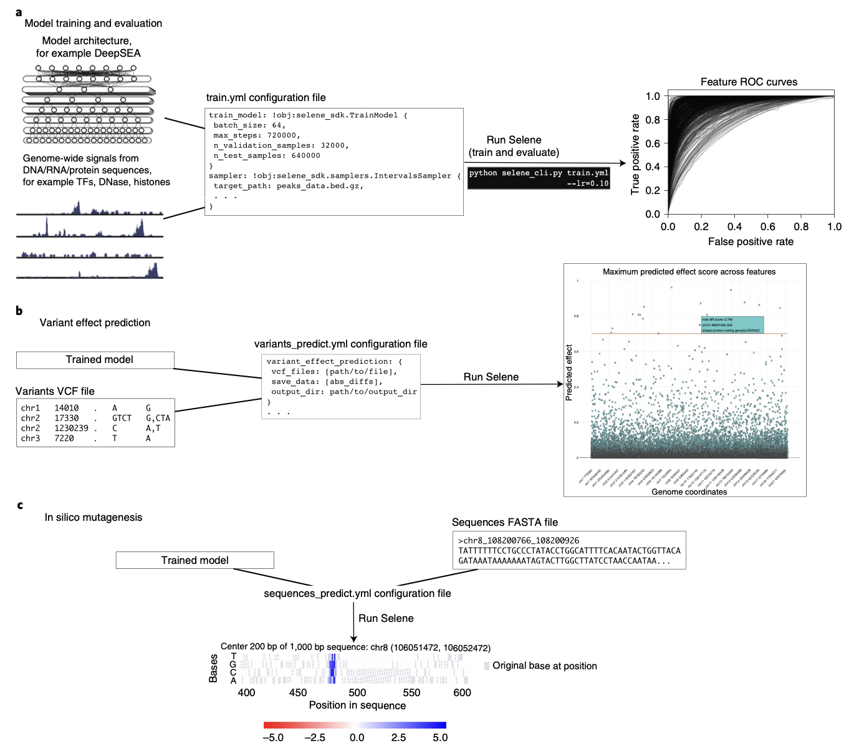
Deep learning resources(二)
(https://selene.flatironinstitute.org)
(Chen KM, et al. Selene: a PyTorch-based deep learning library for sequence data. Nat Methods.)

Slide 33
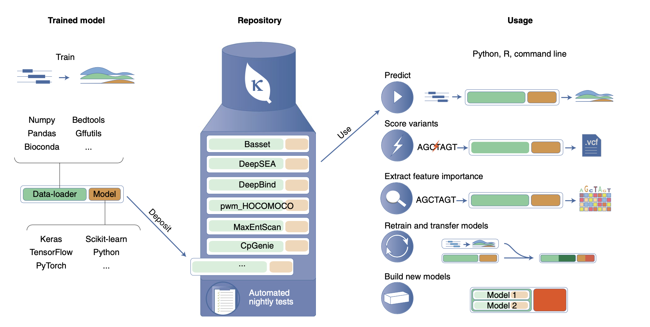
Deep learning resources(三)
(https://kipoi.org)
(Avsec Ž, et al. The Kipoi repository accelerates community exchange and reuse of predictive models for genomics. Nat Biotechnol.)

Slide 34
Build deep learning model from scratch
Practice: construct a model for predicting chromatin accessibility from scratch
https://colab.research.google.com

